Slide 1
A CHATBOT FOR MENTAL HEALTH SUPPORT
Submitted by:
Name – S.Priyavarthini
Dept No – 23-PDS-019

Slide 2
INDEX:
Abstract
Introduction
Objectives
Methodology
Result and Conclusion
Future work
Reference

Slide 3
ABSTRACT
Mental health issues are widespread in countries all over the world. However, there is a global shortage of human resources to provide mental health services. Untreated mental disorders may lead to an increase in suicide attempts and mortality. To address this matter of limited resources, conversational agents have gained momentum in the last few years.
In this work, we introduce WEtalk, a mobile application with an integrated chatbot that implements methods from cognitive behaviour therapy (CBT) to support mentally ill people in regulating emotions and dealing with depression and anxiety.
WEtalk asks the user daily about events that occurred and about their emotions. It automatically determines the basic emotion of a user from the natural language input using natural language processing. Depending on the emotion, an appropriate measurement such as activities or mindfulness exercises is suggested by WEtalk.

Slide 4
INTRODUCTION
Mental health disorders may influence 29% of people in their lifetime and may affect 25% of adults and 10% of children in a year. Mental health disorders can cause disability which also leads to a decrease in the quality of life measured.
Mental health disorders are normally treated by pharmacotherapy or psychotherapy. However, there is a global shortage of mental health professionals. World estimates show that there are nine psychiatrists per 100,000 people available in developed countries and one psychiatrist for every ten million people in developing countries
To address this matter of limited resources for treating persons with mental health disorders, conversational agents have gained more interest in the past five years in the areas of psychoeducation, behaviour change and self-help

Slide 5
OBJECTIVES
I aim to develop a user-friendly chatbot to increase the accessibility of
mental health support, allowing individuals to seek assistance conveniently
and provide instant responses to user queries, ensuring timely support for
individuals experiencing emotional distress or seeking guidance.

Slide 6
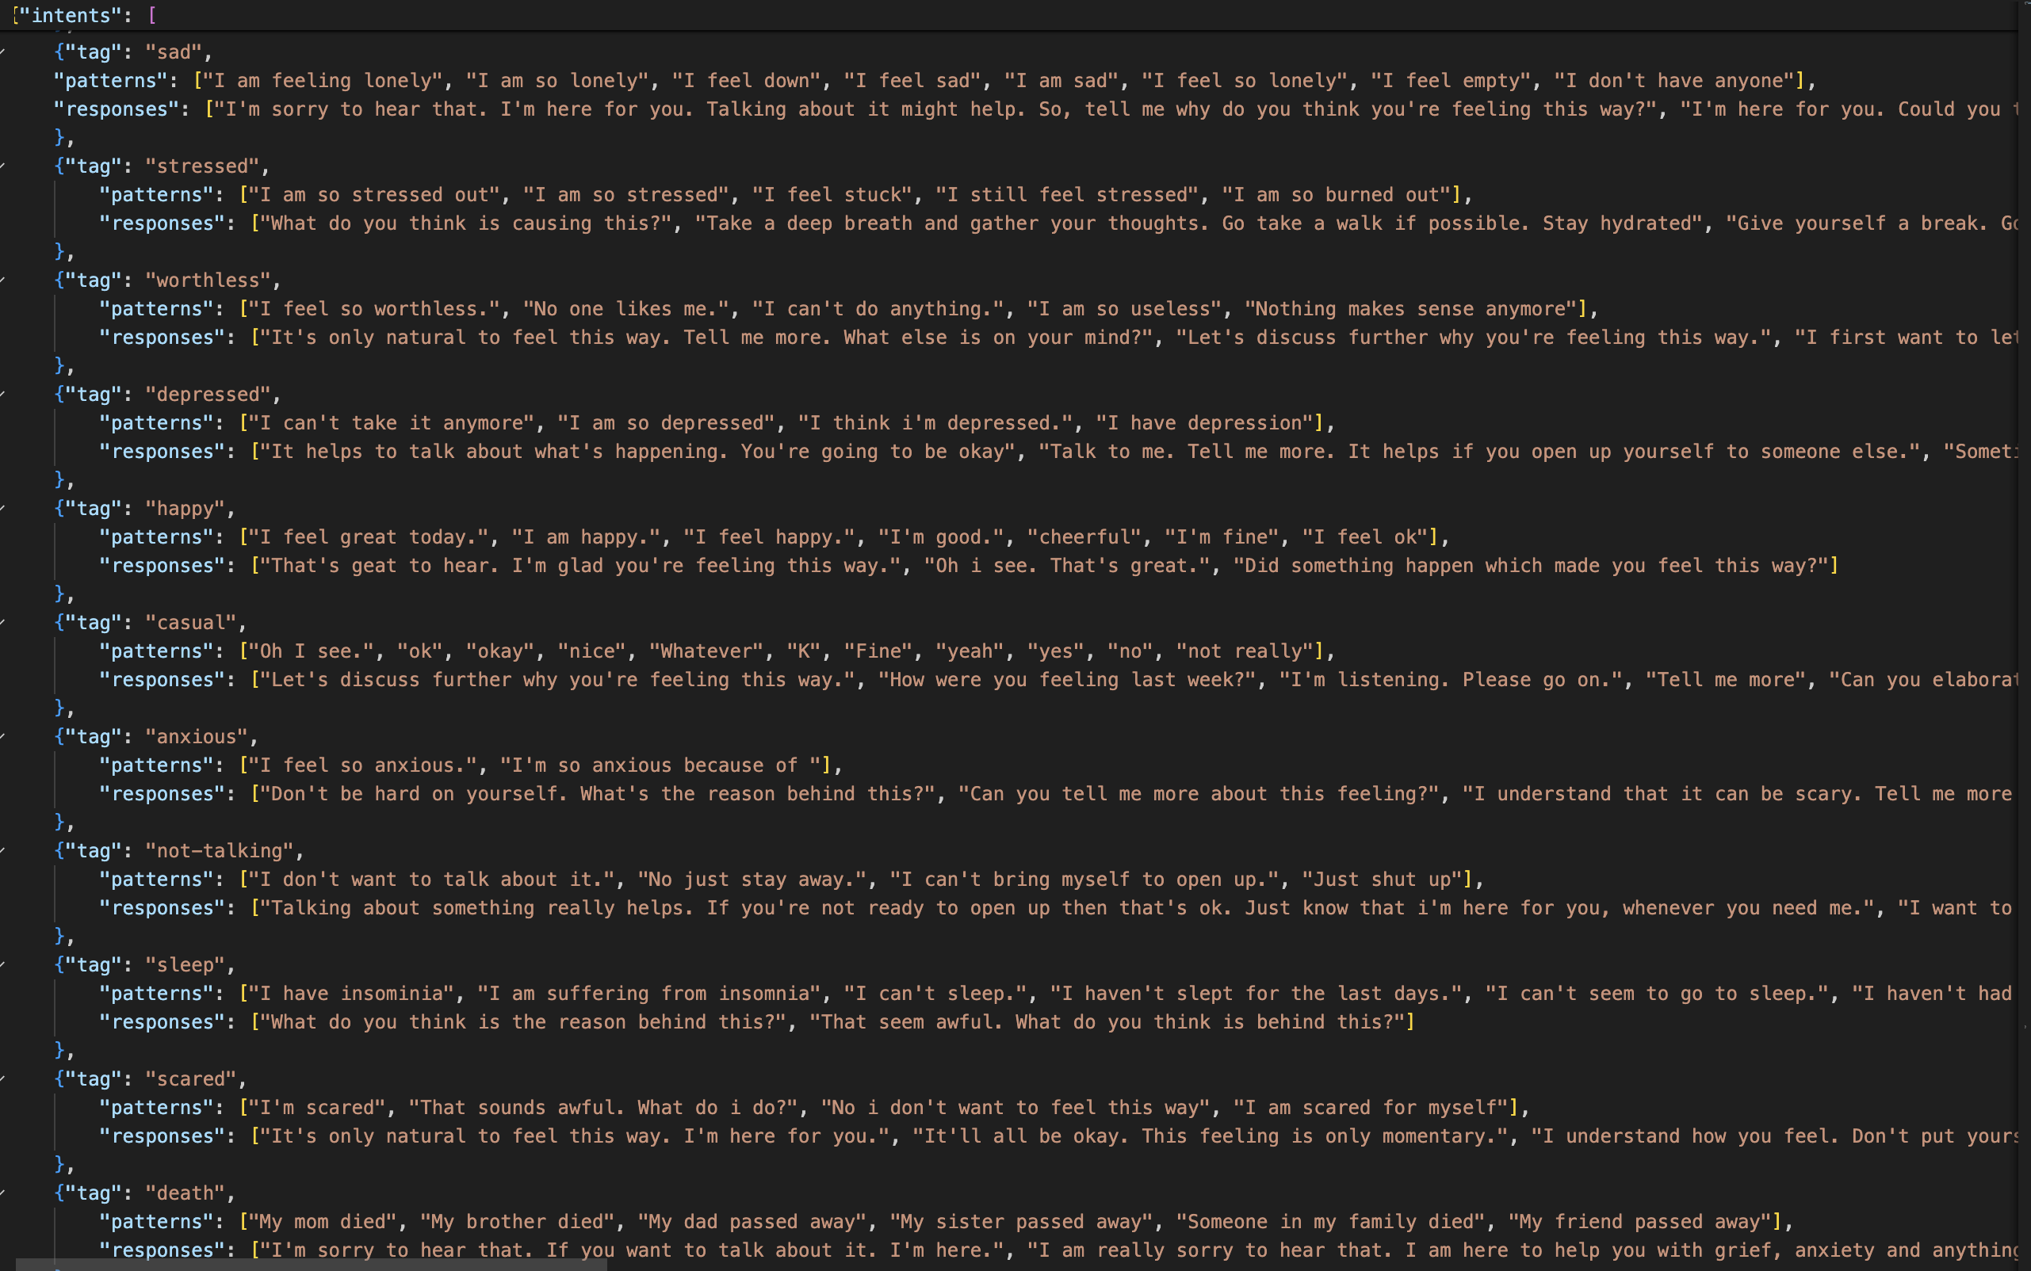
DATA DESCRIPTION
This Dataset contains basic conversations, mental health FAQs, classical therapy conversations, Doctors' contact details and general advice provided to people suffering from anxiety and depression.
This dataset contains intents. An “intent” is the intention behind a user's message. For instance, If I were to say “I am sad” to the chatbot, the intent, in this case, would be “sad”. Depending upon the intent, there is a set of Patterns and Responses appropriate for the intent.

Slide 7
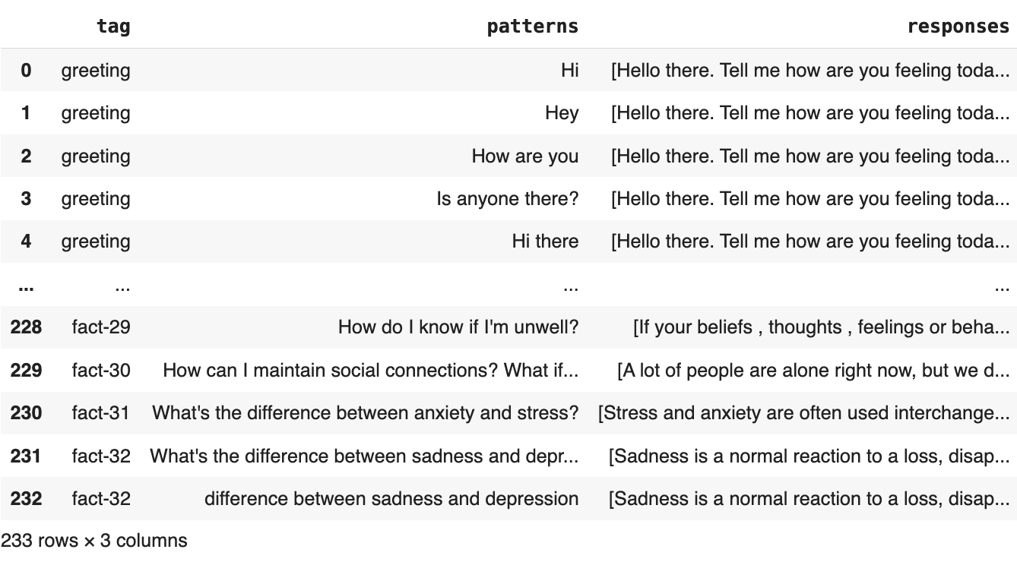
METHODOLOGY
i)Dataset Representation: The dataset for training the chatbot consists of pairs of input patterns(texual messages), tags and their corresponding labels(mental health-related categories or classes).
ii)Tagging User Inputs: When a user sends a message to the chatbot, the input is analyzed and tagged based on its content and context. These tags can include information such as the user's mood, specific mental health concerns, or the type of support they're seeking.

Slide 8
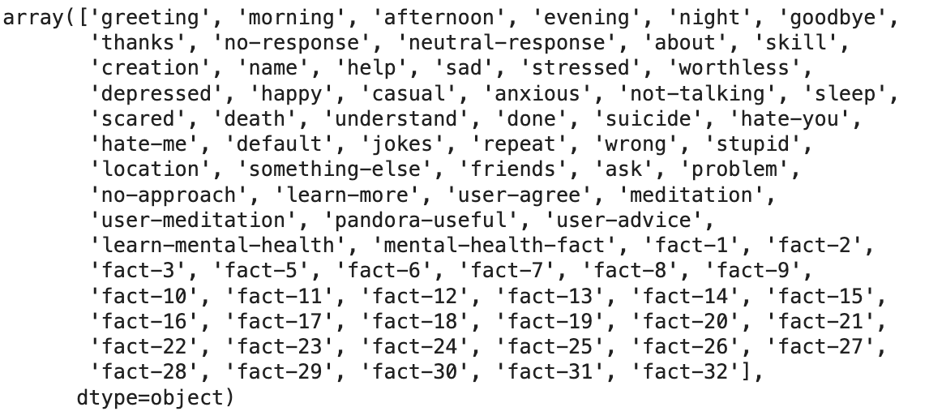
iii) Ensuring Uniqueness: With the ‘tag.unique’ approach, each user input is associated with only one unique tag or label. This means that even if a user's message contains multiple keywords or phrases relevant to different tags, the chatbot will prioritize and assign a single tag that best represents the user's primary intent or concern. Below figure is the response for ‘tag.unique’
iv) Pattern Matching and Response Generation: Once the user input is tagged with a unique label, the chatbot matches it against a predefined set of patterns or templates stored in its database. These patterns represent issues related to mental health. Based on the identified tag, the chatbot retrieves the corresponding response associated with that tag. This response is designed to address the user's primary concern or query in a relevant and personalized manner.

Slide 9
v) Preprocessing:
Tokenization: In natural language processing, tokenization is the text pre-processing task of breaking up the text into smaller components of text which is also known as tokens.
Text Normalization: In natural language processing, normalization encompasses many text preprocessing tasks including stemming, lemmatization, upper or lowercasing, and stopwords removal
Stemming: In natural language processing, stemming is the text preprocessing normalization task concerned with bluntly removing word affixes (prefixes and suffixes).
Lemmatization: In natural language processing, lemmatization is the text preprocessing normalization task concerned with bringing words down to their root forms.
Stopword Removal: In natural language processing, stopword removal is the process of removing words from a string that don’t provide any information about the tone of a statement.
vi) Pad sequencing and label encoding:
Pad_Sequences is used to ensure that all sequences in a list have the same length by padding shorter sequences with zeros or truncating longer sequences.
LabelEncoder is used to encode categorical labels as integers, which is often necessary for training machine learning models. Overall, this code segment prepares the textual patterns and corresponding tags for training a machine learning model, ensuring that the input data is properly formatted and encoded for the model to learn effectively.

Slide 10
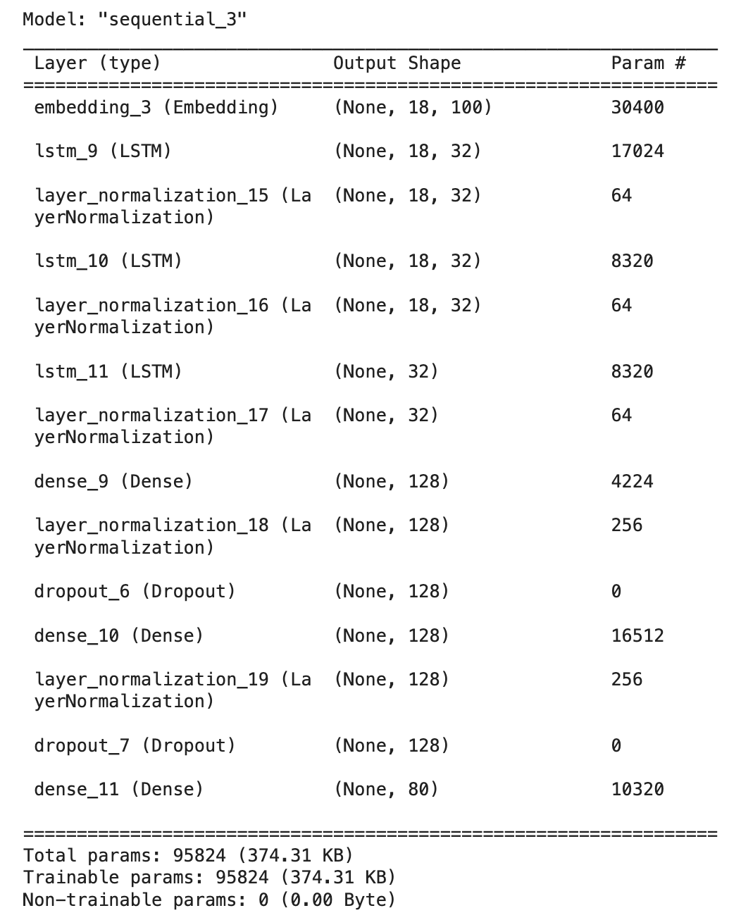
vii)Compiling a sequential DL model using TensorFlow/Keras:
Embedding Layer: The Embedding layer is used to convert input text data into dense vectors of fixed size, also known as word embeddings.
LSTM (Long Short-Term Memory) Layer: The LSTM layer is a type of recurrent neural network (RNN) layer designed to handle sequence data, such as text.
Layer Normalization: Layer normalization is a technique used to normalize the activations of each layer in the neural network.
Dense (Fully Connected) Layer: The Dense layer is a standard fully connected layer in a neural network architecture.
Dropout Layer: The Dropout layer is a regularization technique used to prevent overfitting in deep learning models.

Slide 11
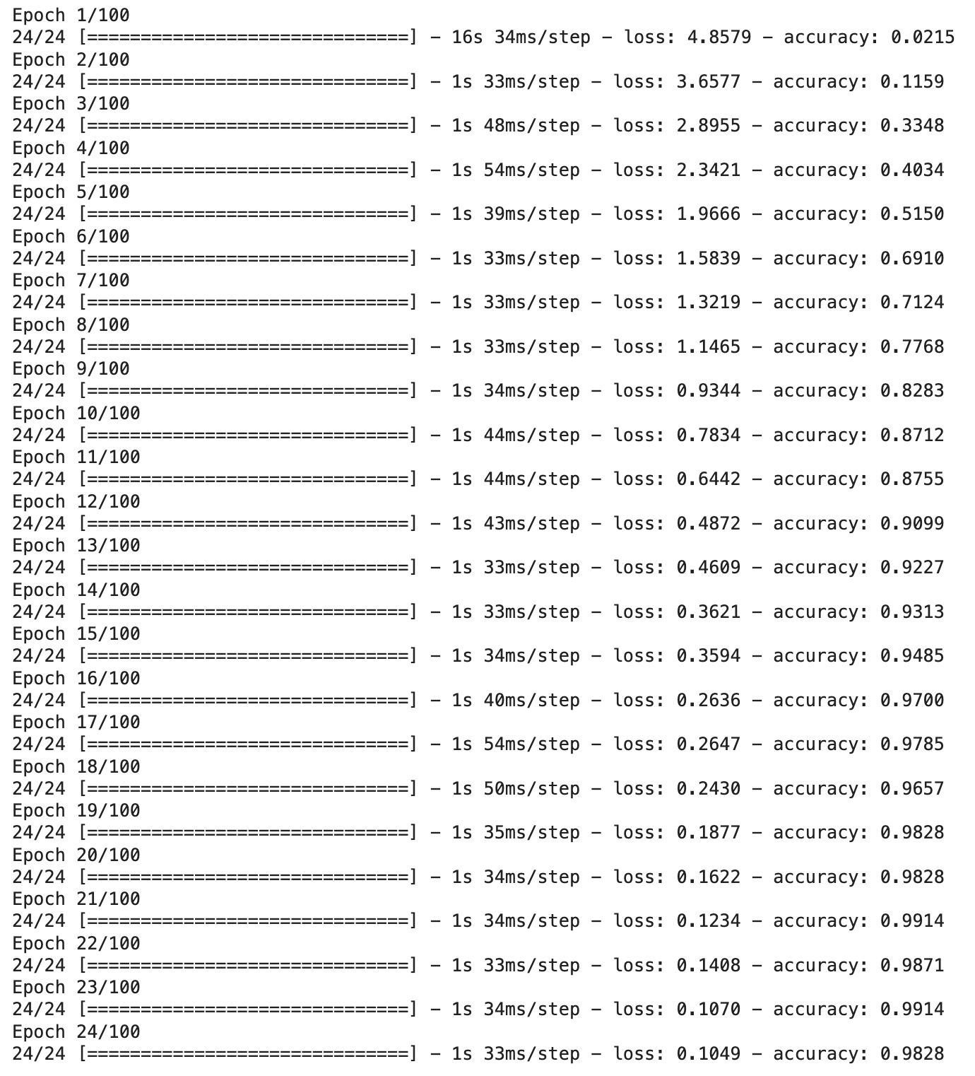
viii)Training Process:
During each epoch, the training algorithm processes the entire dataset in batches. Each batch contains a subset of the dataset, and the model's parameters (weights and biases) are updated based on the loss calculated from the predictions made on that batch.
Overall, epochs play a crucial role in training a deep learning model for a mental health chatbot by allowing the model to iteratively learn from the dataset and refine its parameters to make more accurate predictions and provide meaningful responses to user queries.

Slide 12
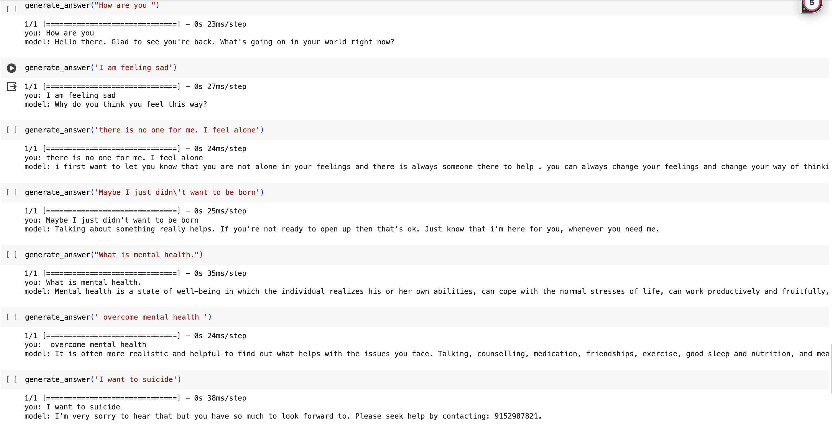
RESULT
This chatbot can revolutionize healthcare with its minimal human interaction. It works on the principle of AI. The communication between the user and the system is text-based. The data is stored in the database and it is retrieved as and when required. Since this chatbot is available 24*7, medications can be provided in case of an emergency or an unfavourable situation. It is a reliable source of medical information.

Slide 13
CONCLUSION
This chatbot provides a user-friendly platform that is easily accessible to anyone with an internet connection. It has the advantage of being around whenever required. This means one does not have to compromise their busy schedule to treat their mental illness. Despite its potential benefits in treating depression, many people are still unaware of this technology. The mental healthcare chatbot has the potential to encourage users to open up and discuss their problems. This project utilizes Python and employs machine learning techniques such as Sequential Model, ML, and NLP to improve the chatbot's accuracy. In the future, this desktop application-based chatbot could be developed further to incorporate video consultancy with a doctor for users who are identified as suffering from depression and stress.

Slide 14
FUTURE WORK
The future scope of the project could be an AI-based healthcare chatbot integrated with wearable devices that could monitor various biometric data, such as heart rate, sleep patterns and activity levels, to provide a personalized support and interventions. For example, if the chatbot detects increased stress levels or disruptions in sleep, it could offer coping strategies, mindfulness exercises, or connect the user with professional help if needed. This integration could offer continuous support and help users better understand their mental health patterns, ultimately leading to improved well-being.

Slide 15
REFERENCES:
Ram Lakhan, A. A. (2020). Prevalence of Depression, Anxiety, and Stress during COVID-19 Pandemic. Banglore: Journal of Neurosciences.
Sahand Sabour, Y. Z. (2023). A chatbot for mental health support: exploring the impact of Emohaa on reducing mental distress in China. China: ORIGINAL RESEARCH article.
Gillian Cameron, D. C. (2018). Assessing the Usability of a Chatbot for Mental Health Care. International Conference on Internet Science .
Abd-alrazaq, M. A. (2019). An overview of the features of chatbots in mental health: A scoping review. International Journal of Medical Informatics .
Aditya Nrusimha Vaidyam, H. W. (2018). Chatbots and Conversational Agents in Mental Health: A Review of the Psychiatric Landscape. The Canadian Journal of Psychiatry.
Kerstin Denecke, S. V. (2020). A Mental Health Chatbot for Regulating Emotions (SERMO) - Concept and Usability Test. IEEE.
Theodora Koulouri, R. D. (2022). Chatbots to Support Young Adults’ Mental Health: An Exploratory Study of Acceptability. ACM Journals.
Oleksandr Romanovskyi, N. P. (2021). Elomia Chatbot: the Effectiveness of Artificial Intelligence in the Fight for Mental Health. Ukraine: International Conference on Computational Linguistics and Intelligent Systems.
Courtney Potts, F. L. (2023). A Multilingual Digital Mental Health and Well-Being Chatbot (ChatPal): Pre-Post Multicenter Intervention Study. JMIR.

Slide 16
THANK YOU!

